Slide 1
5:1-13

Slide 2
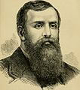
5:1-13
D. L. Moody ~ “I never preached a sermon yet that I could not pick to pieces, and find fault with. I feel that Jesus Christ ought to have a far better representative than I am.”
D. L. Moody (1837-1899)

Slide 3
5:1-13

Slide 4
5:1-13
1 Peter 5:1-14 ~ ¹ The elders who are among you I exhort, I who am a fellow elder and a witness of the sufferings of Christ, and also a partaker of the glory that will be revealed: ² Shepherd the flock of God which is among you, serving as overseers, not by compulsion but willingly, not for dishonest gain but eagerly; ³ nor as being lords over those entrusted to you, but being examples to the flock; ⁴ and when the Chief Shepherd appears, you will receive the crown of glory that does not fade away.
⁵ Likewise you younger people, submit yourselves to your elders.

Slide 5
5:1-13
1 Peter 5:1-14 ~ Yes, all of you be submissive to one another, and be clothed with humility, for
“God resists the proud,
But gives grace to the humble.”
⁶ Therefore humble yourselves under the mighty hand of God, that He may exalt you in due time, ⁷ casting all your care upon Him, for He cares for you.
⁸ Be sober, be vigilant; because your adversary the devil walks about like a roaring lion, seeking whom he may devour. ⁹ Resist him, steadfast in the faith, knowing that the same sufferings are experienced by your
brotherhood in the world.

Slide 6
5:1-13
1 Peter 5:1-14 ~ ¹⁰ But may the God of all grace, who called us to His eternal glory by Christ Jesus, after you have suffered a while, perfect, establish, strengthen, and settle you. ¹¹ To Him be the glory and the dominion forever and ever. Amen.
¹² By Silvanus, our faithful brother as I consider him, I have written to you briefly, exhorting and testifying that this is the true grace of God in which you stand.
¹³ She who is in Babylon, elect together with you, greets you; and so does Mark my son. ¹⁴ Greet one another with a kiss of love.

Slide 7
5:1-13

Slide 8
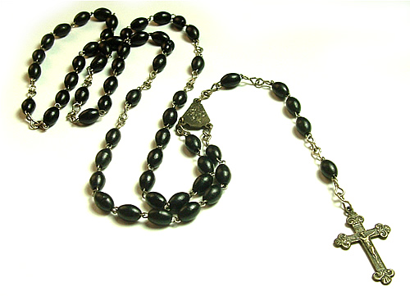
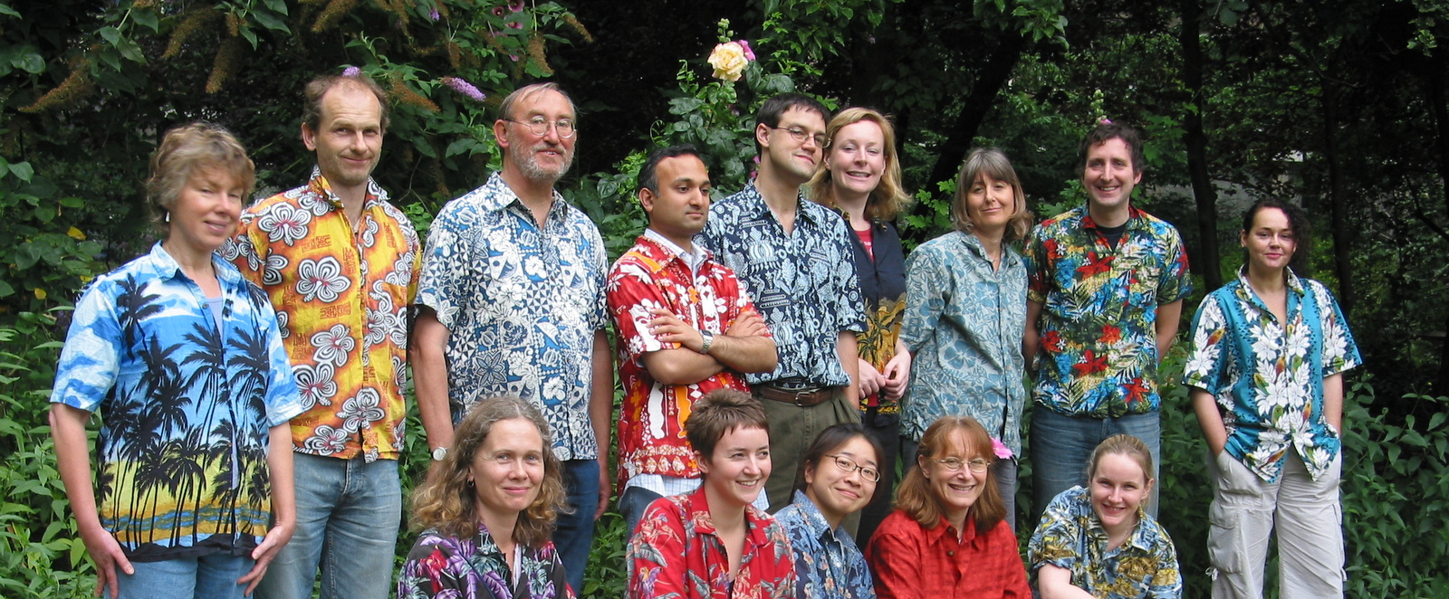
5:1-13

Slide 9
5:1-13

Slide 10
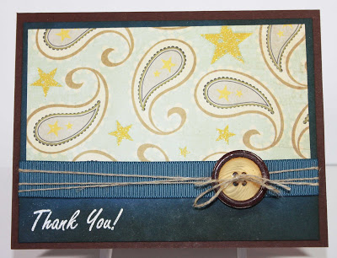
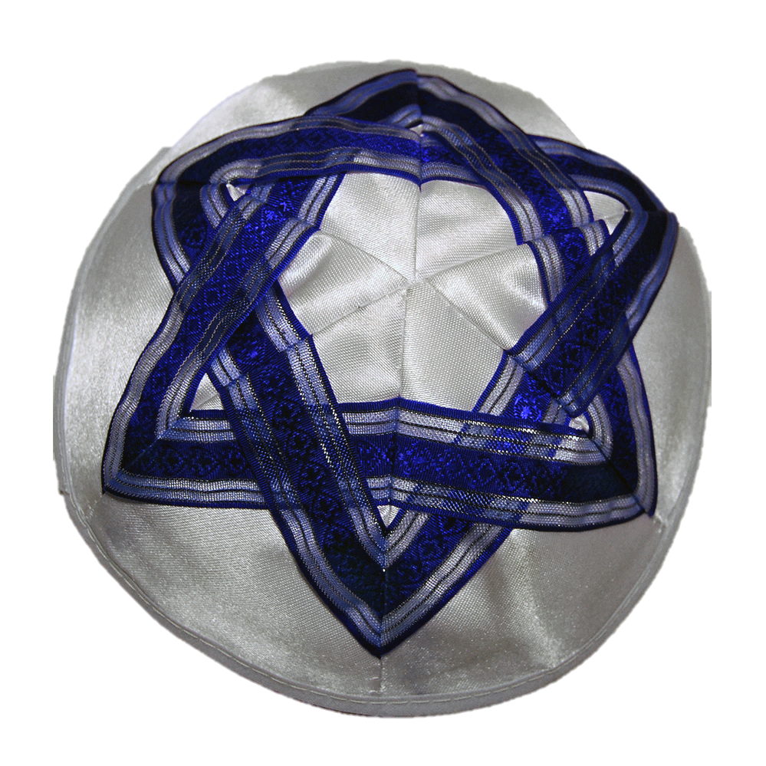
5:1-13

Slide 11
5:1-13

Slide 12
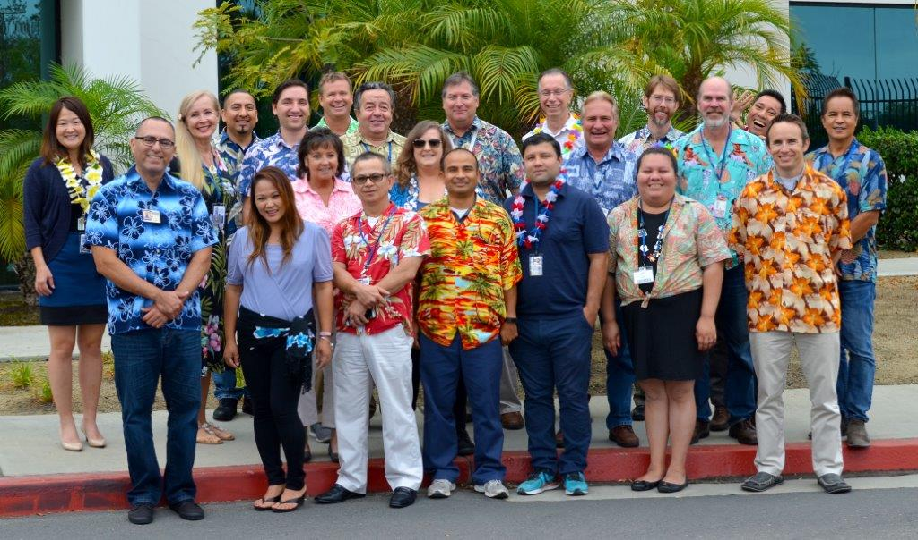
5:1-13

Slide 13
5:1-13

Slide 14
5:1-13
elders (v. 1) ~ presbuteros – elders
Shepherd ~ poimanō – pastors
overseers ~ episkopeō – bishops

Slide 15
5:1-13
Pastors
Bishops
Elders

Slide 16
5:1-13

Slide 17
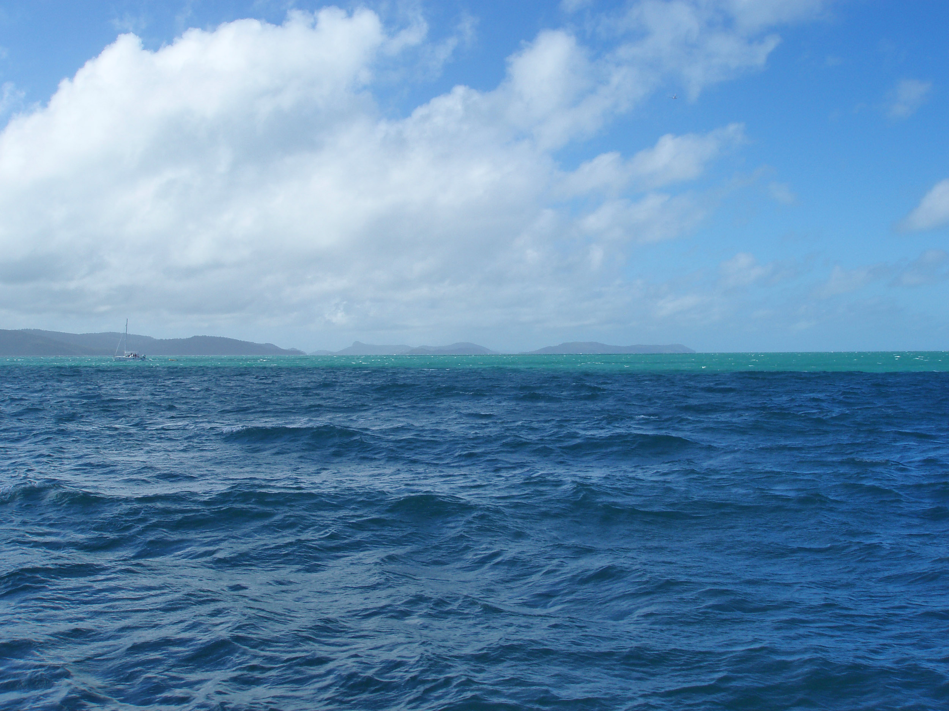
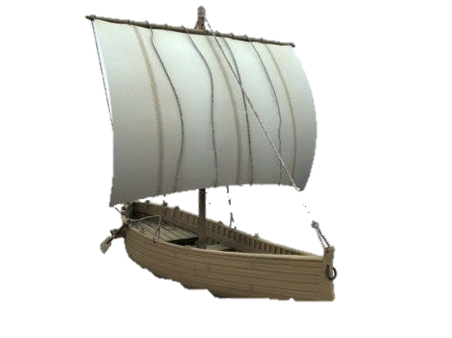
5:1-13
No fish there
3.5’
Gobs of fish here

Slide 18
5:1-13

Slide 19
5:1-13
Shepherd ~ KJV, Feed
NIV, care for
Phillips, I urge you then to see that your “flock of God” is properly fed and cared for.
poimanō – tend, care for, etc.
Same word as in John 21:17 ~ “Tend My sheep”

Slide 20
5:1-13

Slide 21
5:1-13
dishonest gain ~ better, shameful gain
NIV ~ money

Slide 22
5:1-13

Slide 23
5:1-13
examples ~ tupos
Ezek. 34:1-10 ~ God will judge false shepherds of the Old Testament
Ezek. 34:17 ~ But the sheep won’t be able to blame it on the shepherds

Slide 24
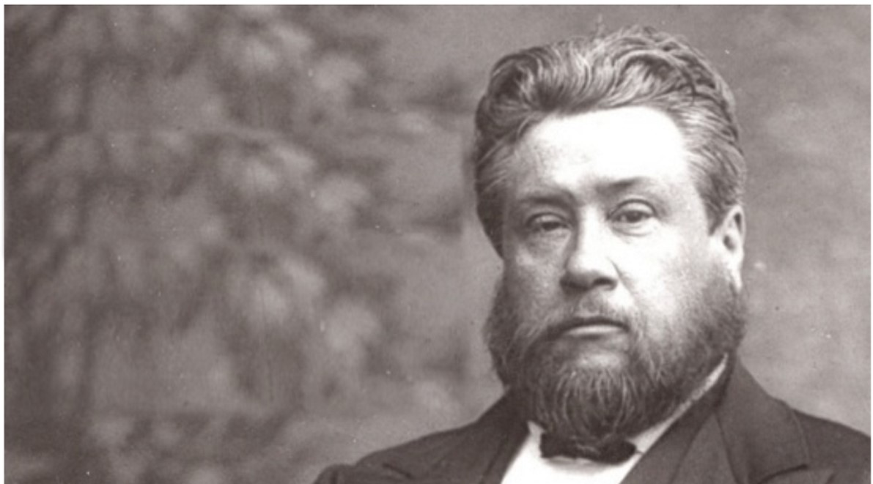
5:1-13
“Growing a beard
is a habit most natural, scripturally, manly, and beneficial.”
C. H. Spurgeon (1834-1892)

Slide 25
5:1-13
“He that can toy with his ministry and count it to be like a trade, or like any other profession, was never called of God. But he that has a charge pressing on his heart, and a woe ringing in his ear,
“A time will come when instead of shepherds feeding the sheep, the church will have clowns
entertaining the goats.”
C. H. Spurgeon (1834-1892)

Slide 26
5:1-13
and preaches as though he heard the cries of hell behind him, and saw his God looking down on him – oh, how that man entreats the Lord that his hearers may not hear in vain!”
“A time will come when instead of shepherds feeding the sheep, the church will have clowns
entertaining the goats.”
C. H. Spurgeon (1834-1892)

Slide 27
5:1-13

Slide 28
5:1-13
2 Cor. 5:10 ~ For we must all appear before the judgment seat of Christ, that each one may receive the things done in the body, according to what he has done, whether good or bad.

Slide 29
5:1-13

Slide 30
5:1-13
clothe ~ enkomboomai – a servant’s apron

Slide 31
5:1-13
Is. 57:15 ~ For thus says the High and Lofty One
Who inhabits eternity, whose name is Holy:
“I dwell in the high and holy place,
With him who has a contrite and humble spirit,
To revive the spirit of the humble,
to revive the heart of the contrite ones.
Prov. 18:12 ~ Before destruction the heart of a man is haughty,
And before honor is humility.

Slide 32
5:1-13
Pr. 6:17 ~ a proud look …
Pr. 16:18 ~ Pride goes before destruction,
Pr. 11:2 ~ When pride comes then comes shame, but with the humble is wisdom.
Pr. 13:10 ~ By pride comes nothing but strife,

Slide 33
5:1-13

Slide 34
5:1-13
“Well, It wasn’t that good”
“It wasn’t me … it was the Lord”
False humility

Slide 35
5:1-13
“Ever since I memorized
the book of Revelation, everyone
has been calling me to ask questions about the
End Times”
Humble brag

Slide 36
5:1-13

Slide 37
5:1-13
casting ~ ekballō
care ~ from a word meaning separation to the point of distraction
cares ~ from a word meaning to be concerned for

Slide 38
5:1-13

Slide 39
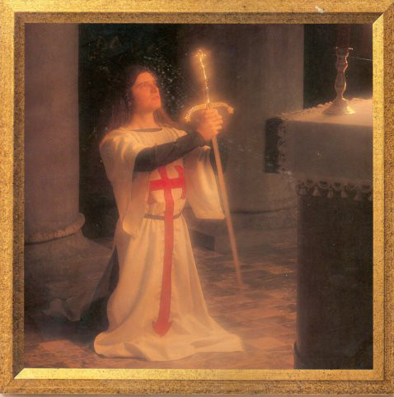
5:1-13
vigilant ~ grēgoreō
adversary ~ antidikos – the opposing attorney
The “Vigil”

Slide 40
5:1-13

Slide 41
5:1-13
Jam. 4:7 ~ Therefore submit to God. Resist the devil and he will flee from
all y’all.
you.

Slide 42
5:1-13

Slide 43
5:1-13
Devil (diabolos) ~ slanderer (not true – he does this before us)
Satan (satanas) ~ accuser (true – he does this before the Lord)
Tempter …
But never Causer

Slide 44
5:1-13

Slide 45
5:1-13
perfect ~ i.e. fit together
establish ~ stērizō
settle ~ to establish a firm foundation

Slide 46
5:1-13

